Slide 1
Swarm intelligence for clustering
Figueiredo, E., Macedo, M., Siqueira, H. V., Santana, C. J., Gokhale, A., & Bastos-Filho, C. J. (2019). Swarm intelligence for clustering — A systematic review with new perspectives on data mining. Engineering Applications of Artificial Intelligence, 82, 313–329. https://doi.org/10.1016/j.engappai.2019.04.007
Luca Visser, Seppe Vanrietvelde and Victor Tuytte
Figueiredo, E., Macedo, M., Siqueira, H. V., Santana, C. J., Gokhale, A., & Bastos-Filho, C. J. (2019). Swarm intelligence for clustering — A systematic review with new perspectives on data mining. Engineering Applications of Artificial Intelligence, 82, 313–329. https://doi.org/10.1016/j.engappai.2019.04.007

Slide 2
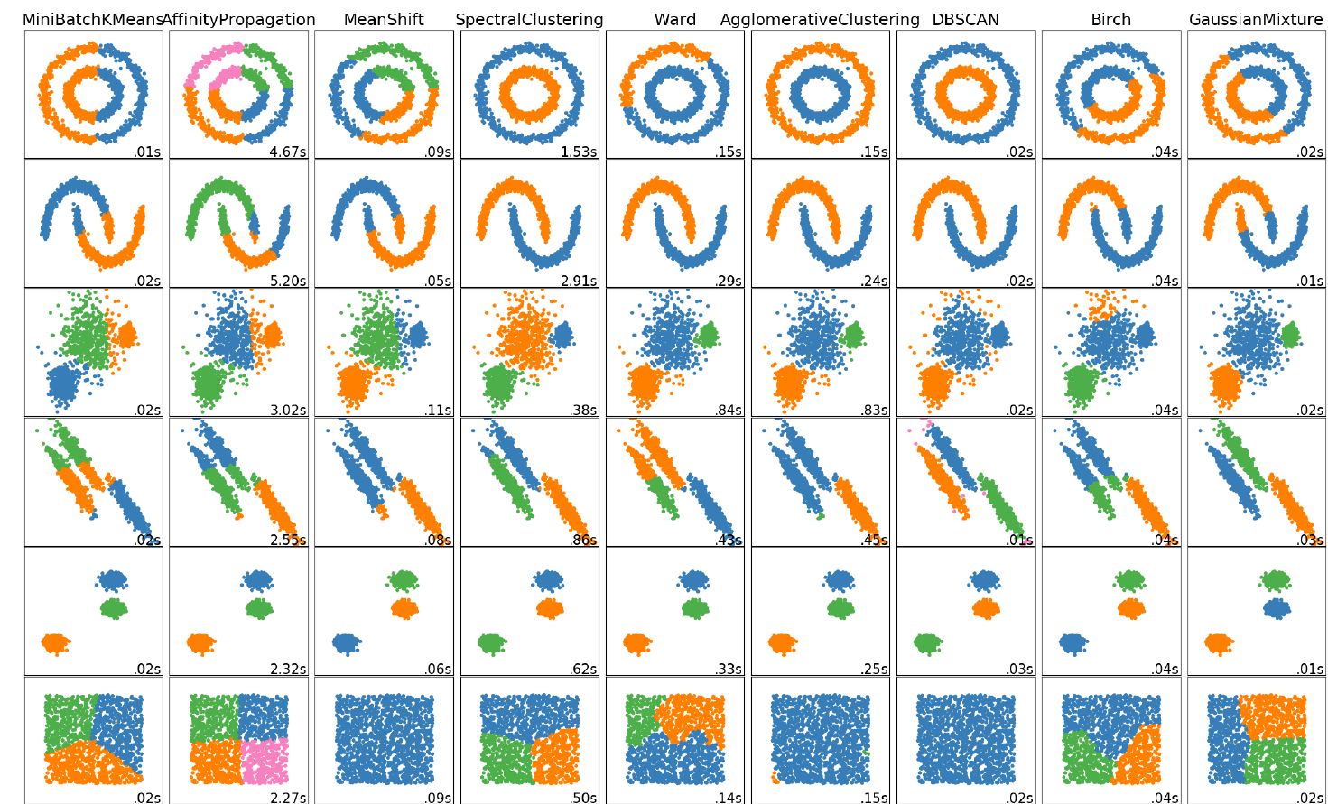
Introduction
Extension of the course topic: Data mining - clustering
Swarm intelligence is yet another group of techniques for clustering

Slide 3
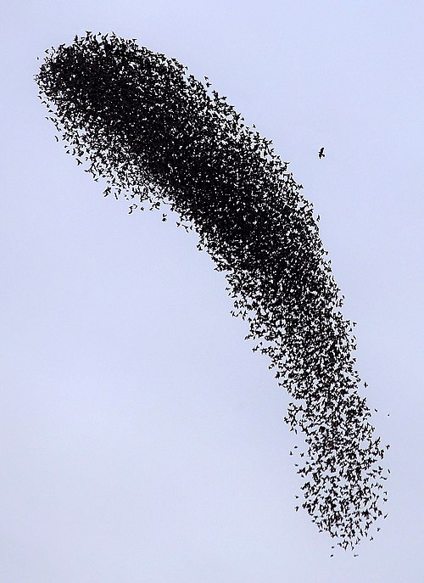
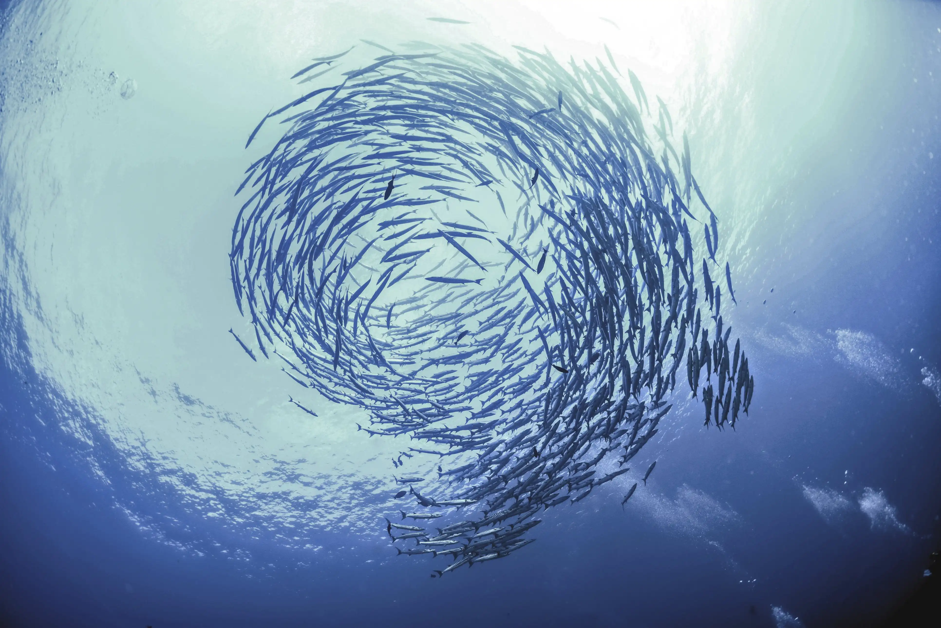
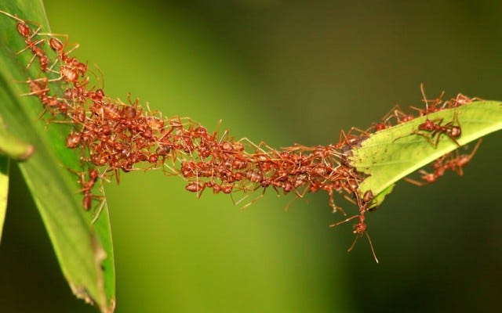
What is swarm intelligence?
Nature inpired algorithms
Many simple communicating agents
Collective, self-organizing behaviour
Used for optimization

Slide 4
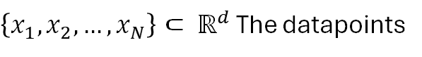
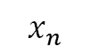
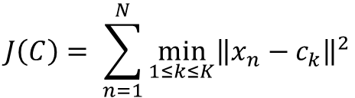
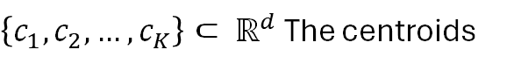
How can it be used for clustering?
The problem? -> The ideal places to put centroids!
$$J\left(C\right)= \sum_{n=1}^{N}{\min_{1≤k≤K}{{\left\|x_{n}−c_{k}\right\|}^{2}}}$$
Minimize the objective function:
With:
$\left\{x_{1}, x_{2}, …, x_{N}\right\}⊂ ℝ^{d}$ The datapoints
$\left\{c_{1}, c_{2}, …, c_{K}\right\}⊂ ℝ^{d}$ The centroids
$$x_{n}$$
$$c_{k−1}$$
$$c_{k}$$
A d x K dimensional problem with possible local minima

Slide 5
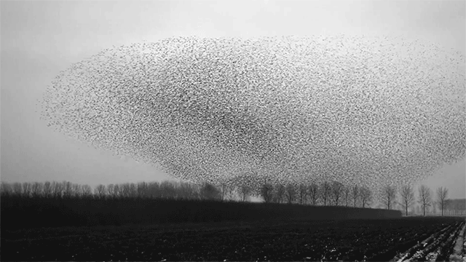
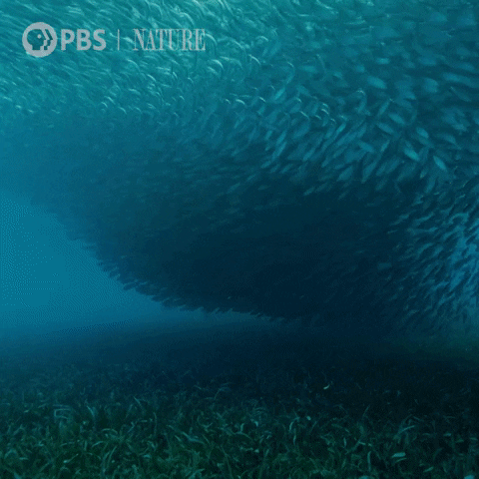
Particle Swarm Optimization
Notes:
Explanation (can be more detailed – multiple slides)

Slide 6
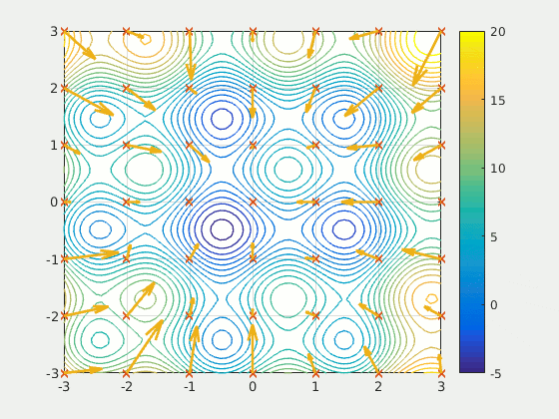
PSO: Intuitively
Imagine a group of hikers are interested in finding the lowest point in a mountain range
Every iteration represents a day of searching
The hikers can communicate with each other
Credits: https://www.youtube.com/watch?v=JhgDMAm-imI&t=1s&pp=ygUlcGFydGljbGUgc3dhcm0gb3B0aW1pemF0aW9uIGFsZ29yaXRobQ%3D%3D
Notes:
https://www.youtube.com/watch?v=JhgDMAm-imI&t=1s&pp=ygUlcGFydGljbGUgc3dhcm0gb3B0aW1pemF0aW9uIGFsZ29yaXRobQ%3D%3D

Slide 7
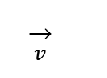
PSO: Mathematically
(Randomly) assign each particle a position and velocity within search bounds
Compute f(x_{i}) for all particles
If f(x_{i}) < f(p_{i}), update personal best p_{i}
If any f(p_{i}) < f(g), update global best g
(x₁, y₁, x₂, y₂, x₃, y₃)
$$\overset{→}{v}$$

Slide 8
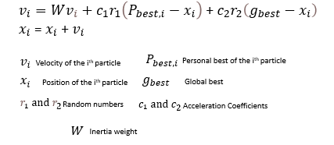
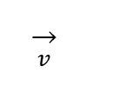
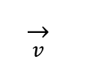
PSO: Mathematically
$$\overset{→}{v}$$
Compute new velocity for all particles
Inertia component (W)
Cognitive component (c₁)
Social component (c₂)
Move all particles and return to step 2 (unless last iteration)
Return global best solution
$$\overset{→}{v}$$

Slide 9
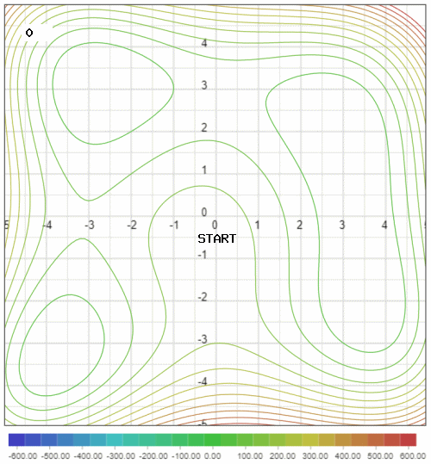
Other frequently used algorithms
Artificial bee colony
Food sources as candidate solutions
Employed bees explore around a food source (local exploitation)
Onlooker bees give attention to the best food source (global best exploitation)
Scout bees abandon non-improving food sources for random new ones (exploration)
Notes:
Artificial bee colony (short description – one slide)

Slide 10
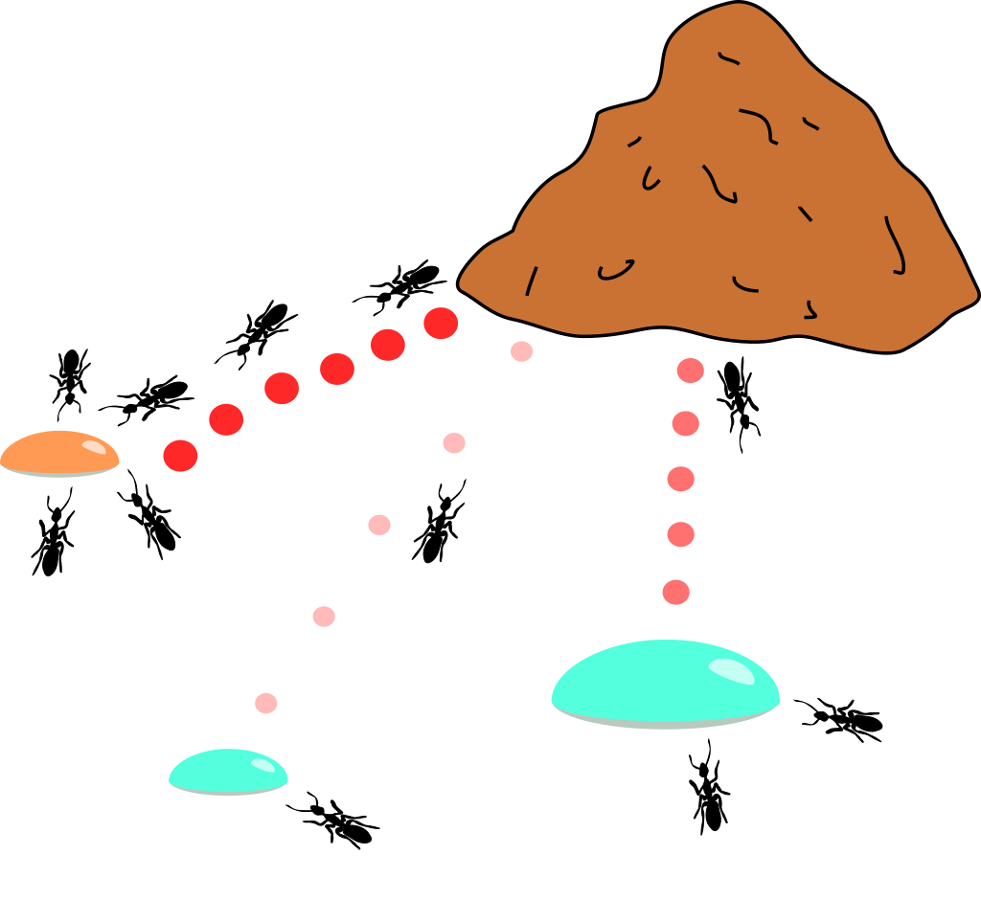
Other frequently used algorithms
Ant colony optimization
Candidate solutions get weights based on importance (pheromone links)
Ants gravitate toward the neighbourhood of a probabilistically chosen solution to find better solutions
Candidate solutions are continuously reweighted (pheromone evaporation)
Notes:
Ant colony optimization (short description – one slide)

Slide 11
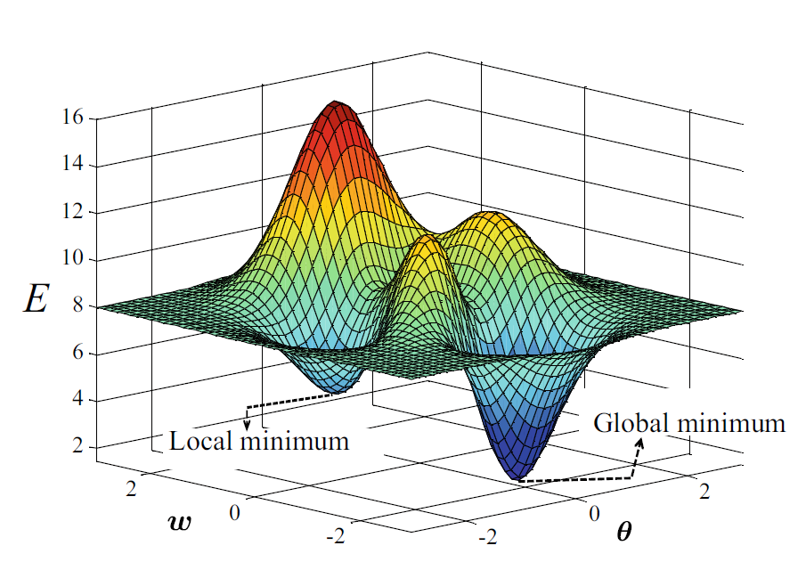
SI algorithms: why are they useful?
Agents share local info to reveal complex clusters
Evaporation/inertia prevent local optima (unlike K-means)
Handles any shape, noise, and outliers naturally
Fewer, clearer parameters; robust to initialization
Notes:
Swarm intelligence can outperform traditional clustering like K‑means by offering a more flexible, global search. While K‑means is fast and easy to use, its random starts and greedy updates often trap it in local optima and struggle with irregular cluster shapes. In contrast, swarm algorithms leverage collective exploration. Agents share information as they search, striking a dynamic balance between probing new regions and refining known solutions, so they’re better at escaping poor minima and uncovering complex, noisy, or high‑dimensional patterns.

Slide 12
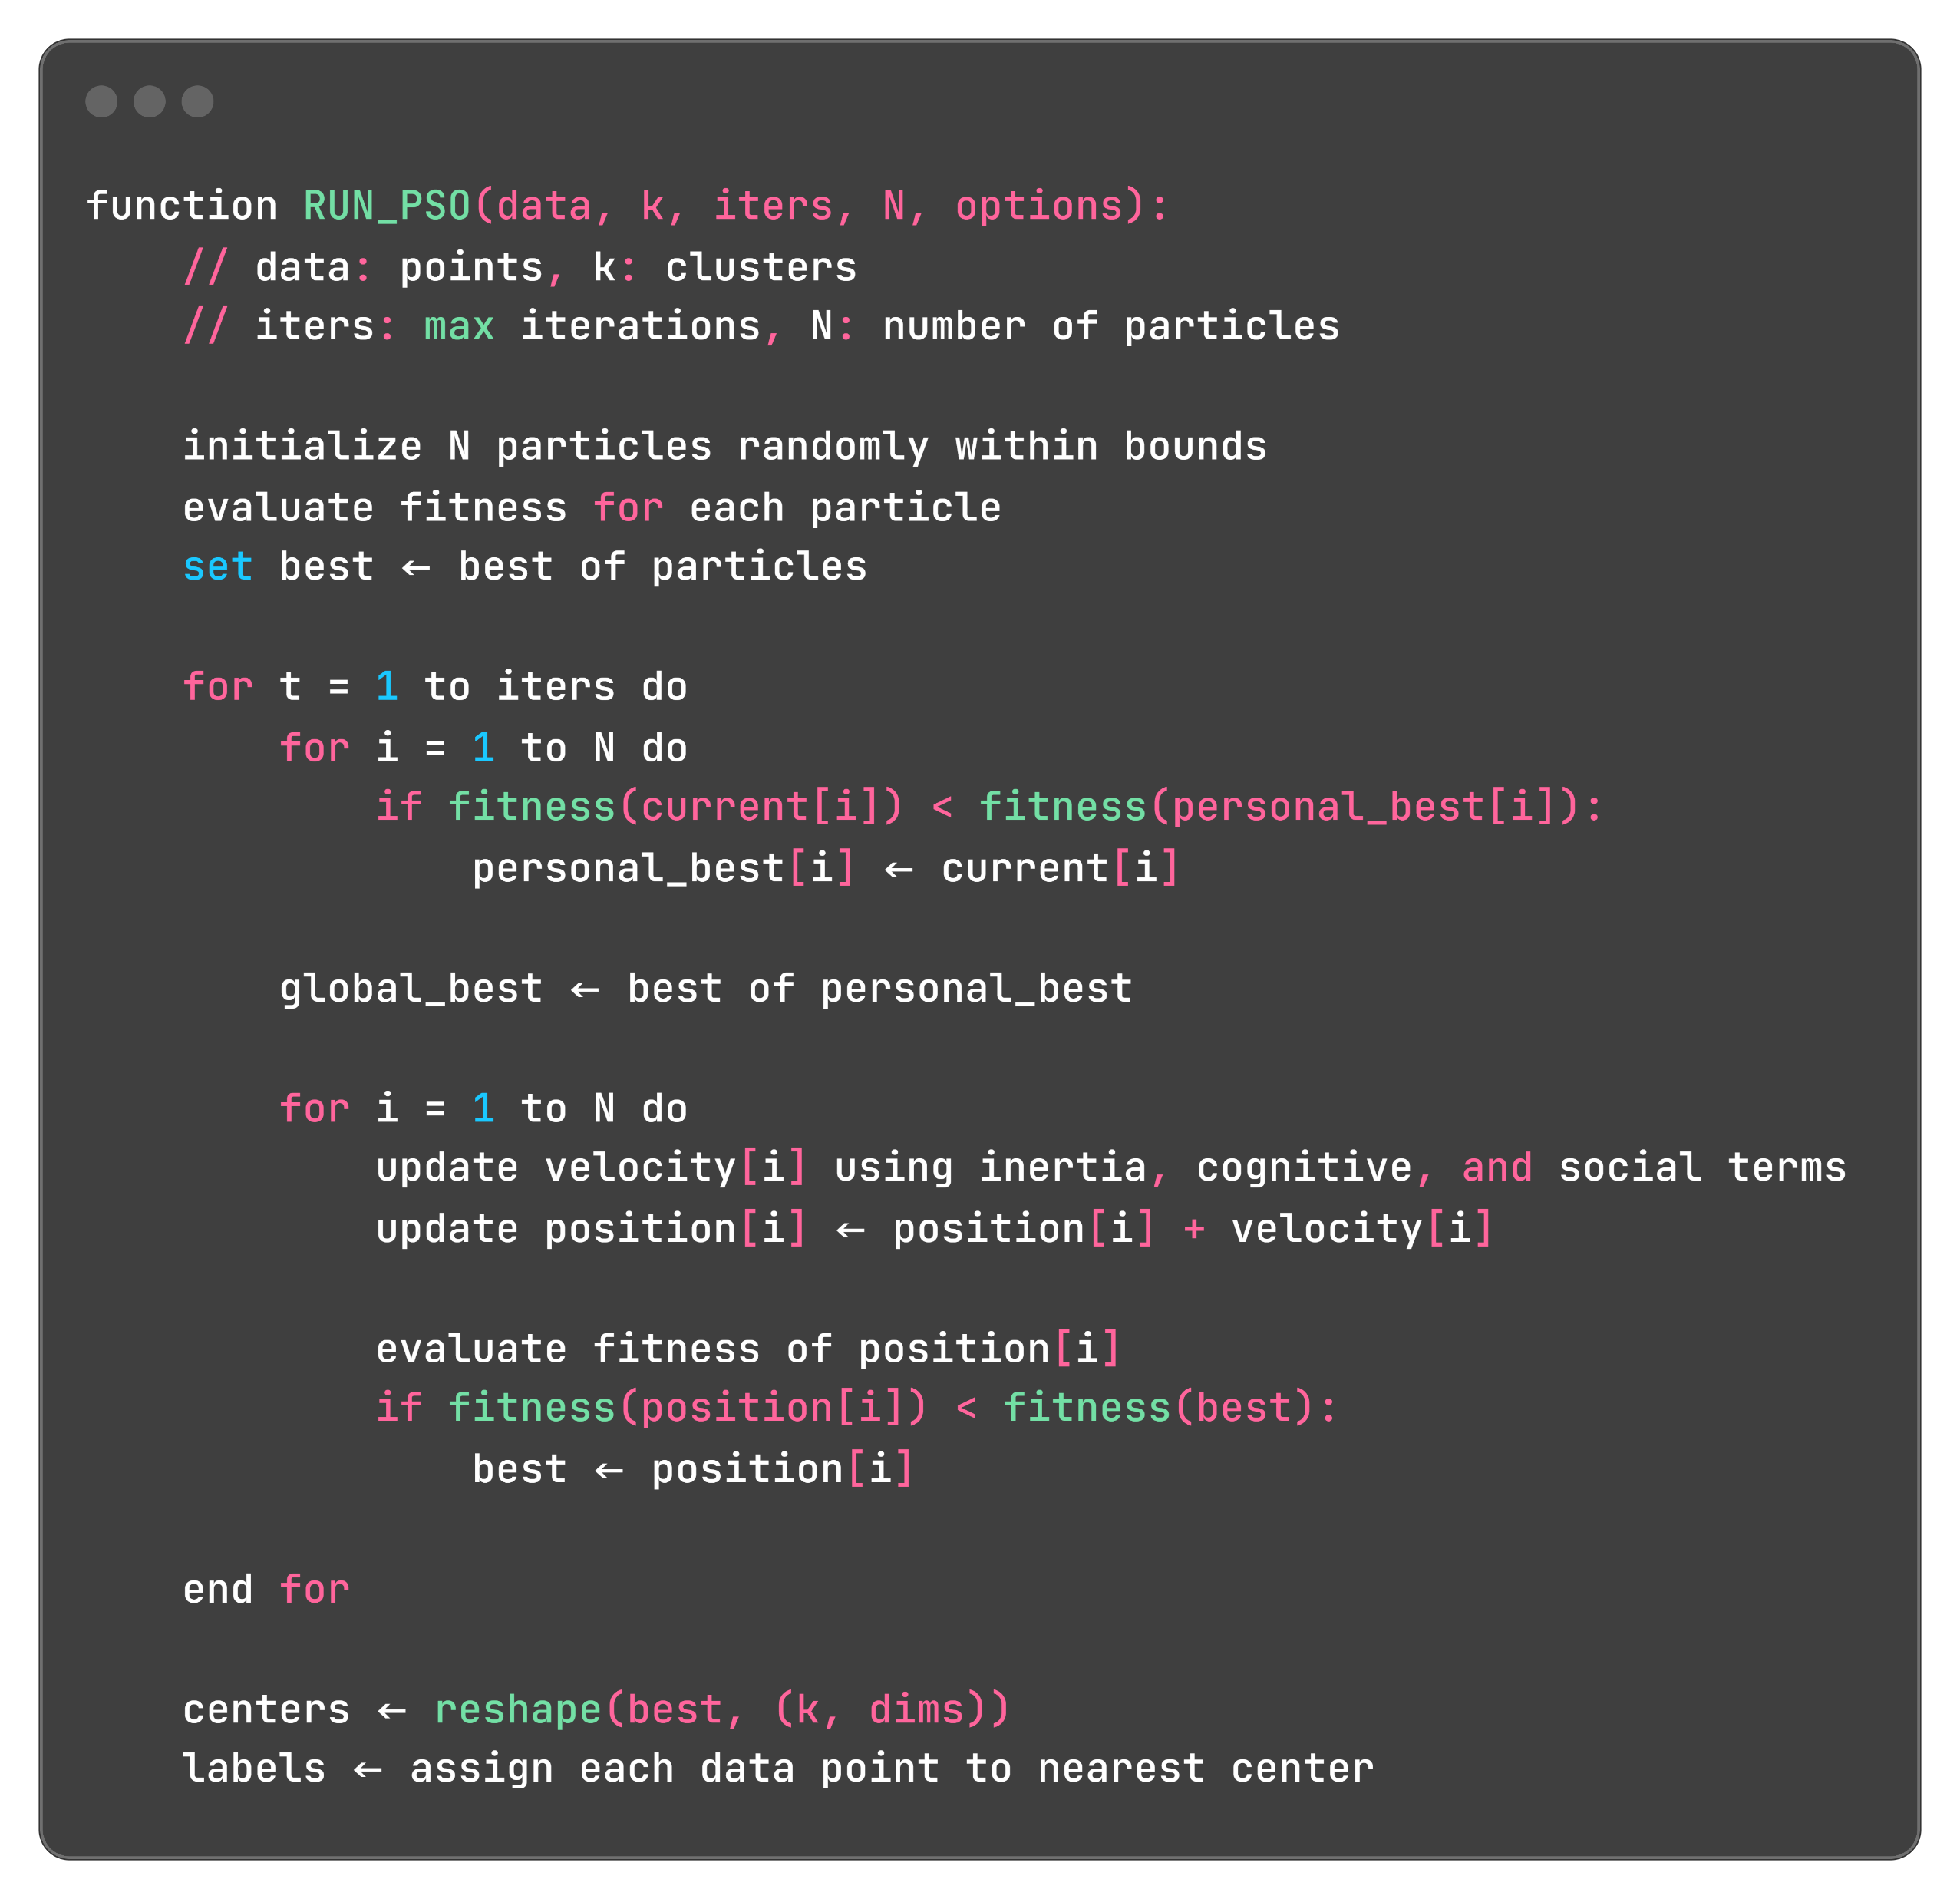
Coded examples: PSO
Notes:
We’ll now walk through coded swarm‑clustering examples, starting each with concise pseudocode and then visualizing particle movements. First up is Particle Swarm Optimization (PSO): we scatter a swarm of candidate solutions (each encoding k cluster centers) across the data space, evaluate their fitness (sum of squared distances), and record the best. Then, for a fixed number of iterations, each particle updates its personal best and the swarm’s global best, adjusts its velocity by blending inertia with pulls toward those bests, and moves accordingly—reevaluating fitness immediately to capture any improvement. At the end, we reshape the global best into cluster centers and assign points to their nearest center. Despite sounding complex, this loop of “evaluate → update bests → move” is surprisingly straightforward once you see it in action.

Slide 13
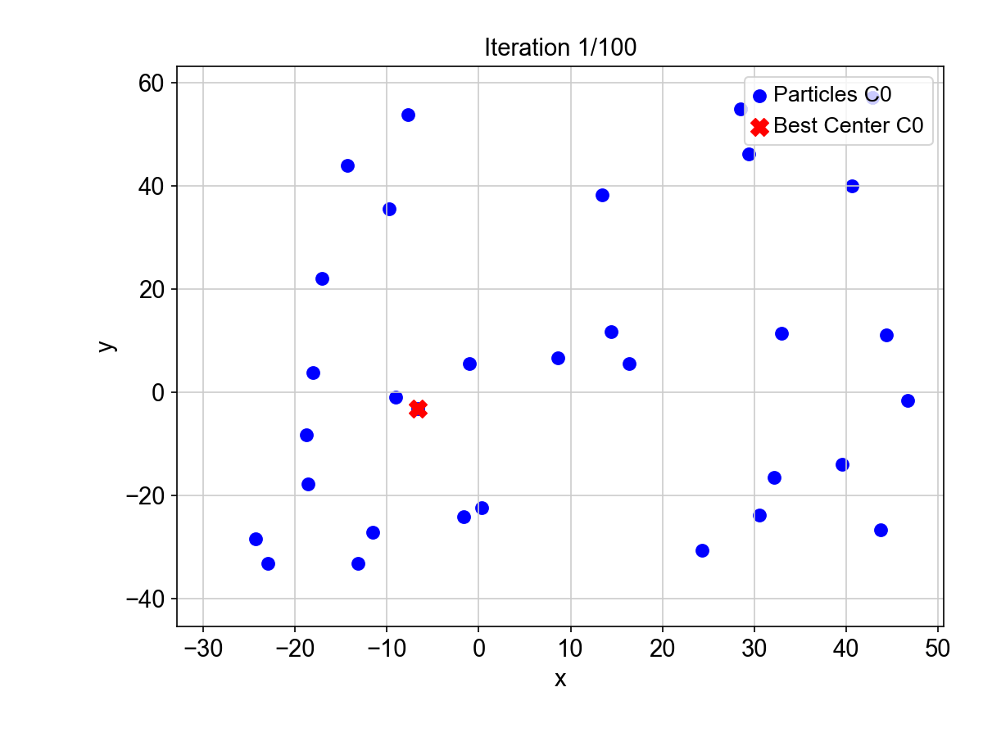
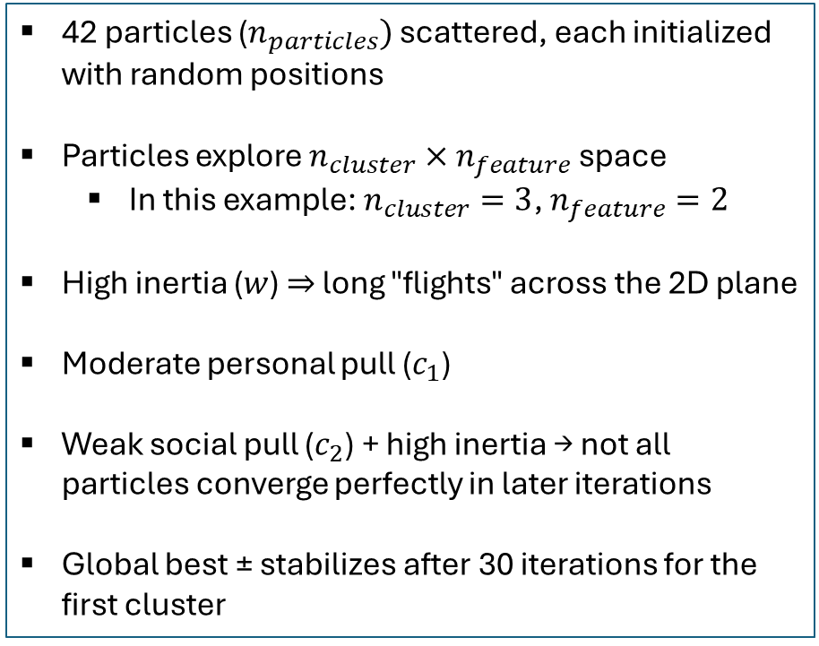
Coded examples: PSO
42 particles ($n_{particles})$ scattered, each initialized with random positions
Particles explore $n_{cluster}×n_{feature}$ space
In this example: $n_{cluster}=3$, $n_{feature}=2$
High inertia ($w$) ⇒ long "flights" across the 2D plane
Moderate personal pull ($c_{1}$)
Weak social pull ($c_{2}$) + high inertia → not all particles converge perfectly in later iterations
Global best ± stabilizes after 30 iterations for the first cluster
Animated graph of first 2 dimensions of each particle (first cluster/centre)
c1=1.22, c2=0.10, w=1.00, n_particles=42, n_clusters=3

Slide 14
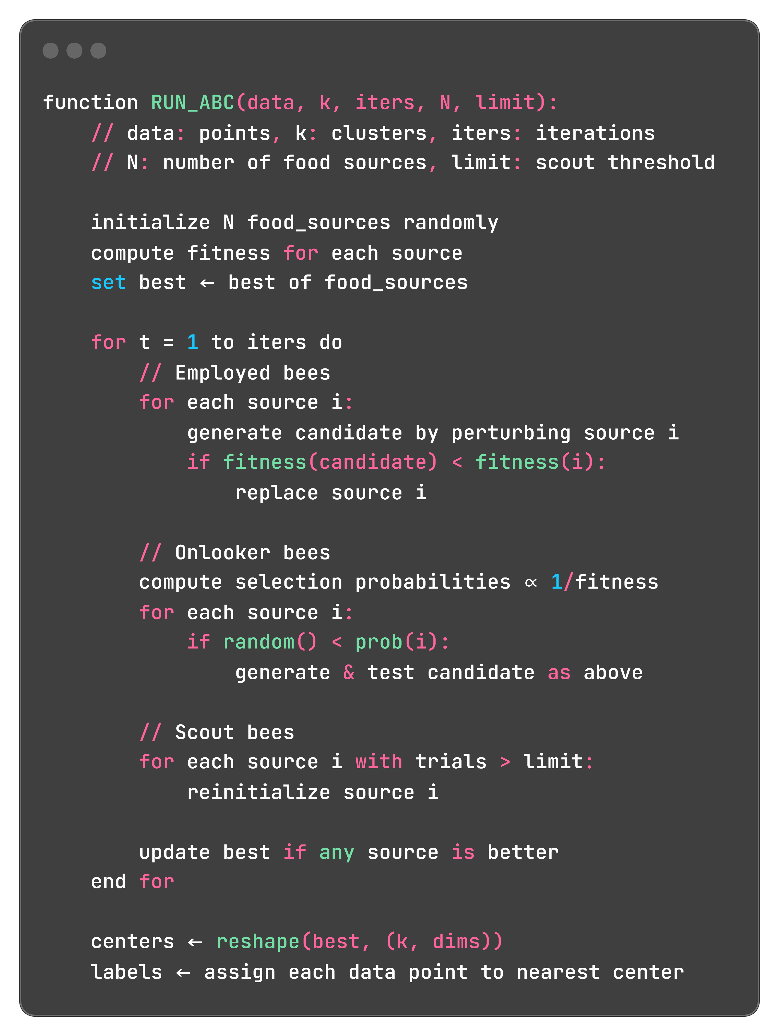
Coded examples: ABC
Notes:
In ABC clustering, you start by scattering N “food sources”—each a candidate set of k centers—evaluate their fitness, and note the best. Each iteration then runs three phases: employed bees tweak sources and replace them if fitness improves; onlooker bees probabilistically explore around better sources; and scout bees reset any source that hasn’t improved after a set number of trials. After each cycle you update the global best, and at the end reshape its coordinates into k centers and assign points accordingly.

Slide 15
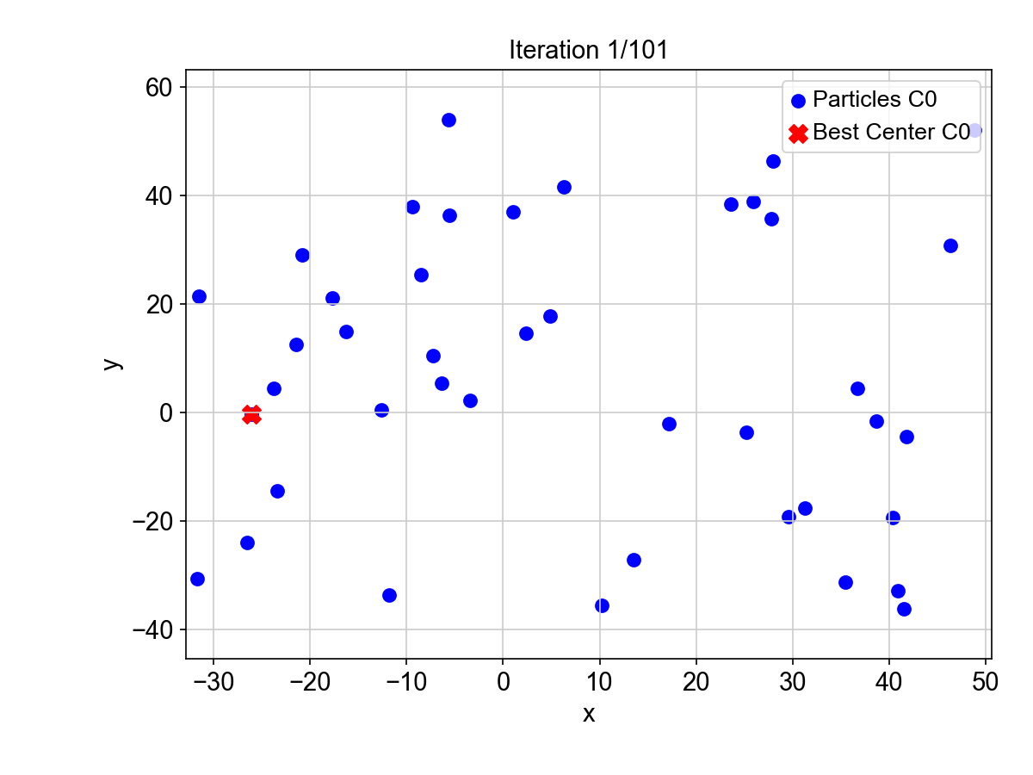
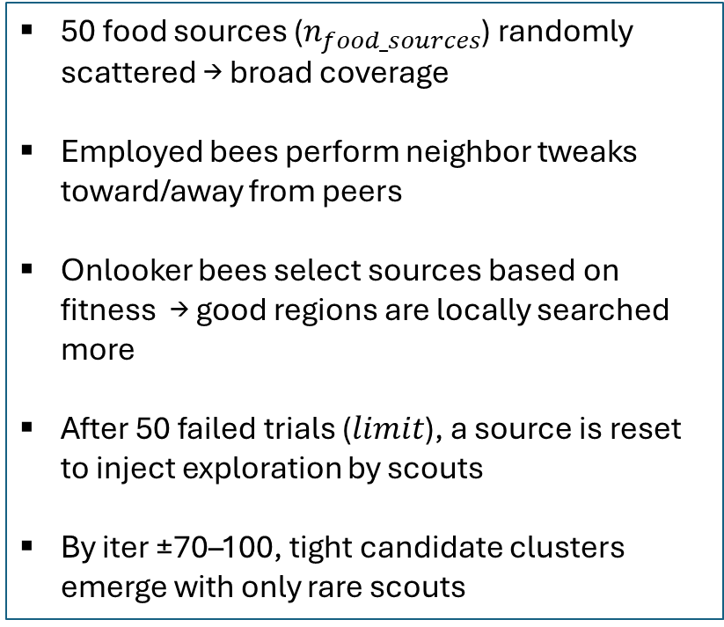
Coded examples: ABC
Animated graph of first 2 dimensions of each particle (first cluster/centre)
50 food sources ($n_{food_sources}$) randomly scattered → broad coverage
Employed bees perform neighbor tweaks toward/away from peers
Onlooker bees select sources based on fitness → good regions are locally searched more
After 50 failed trials ($limit$), a source is reset to inject exploration by scouts
By iter ±70–100, tight candidate clusters emerge with only rare scouts
n_food_sources=50, limit=50, n_clusters=3

Slide 16
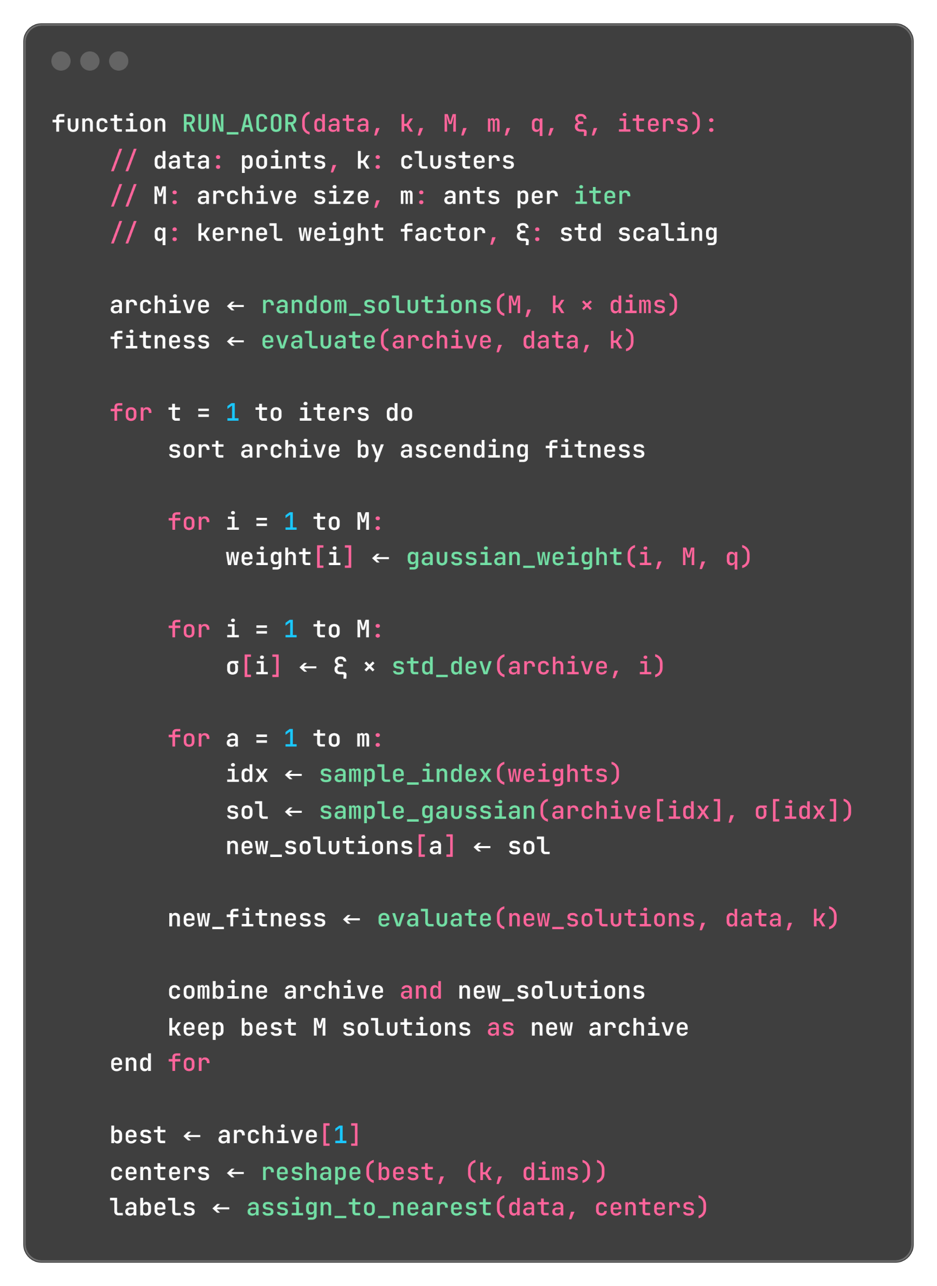
Coded examples: ACOR
Notes:
In ACOR for clustering, you maintain an archive of M candidate solutions (each a flattened list of k centers) and evaluate their fitness; at each iteration you sort these solutions by quality, assign Gaussian‑derived weights and spreads, then deploy m “ants” that sample new candidates from weighted Gaussians centered on archive members. After evaluating the newcomers, you merge and prune back to the top M solutions, repeating until convergence; finally, you reshape the best archive entry into k centers and assign each data point to its nearest center.

Slide 17
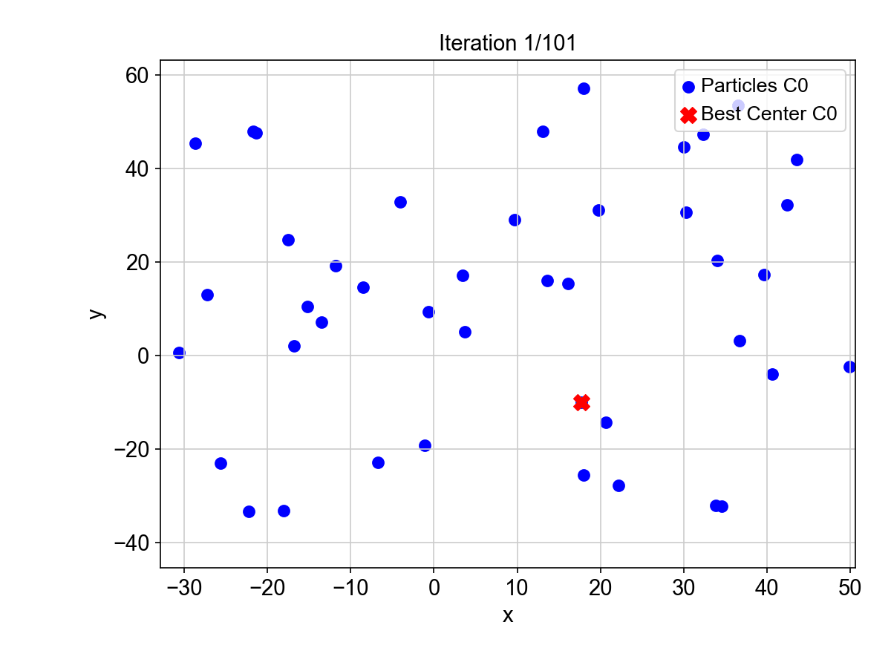
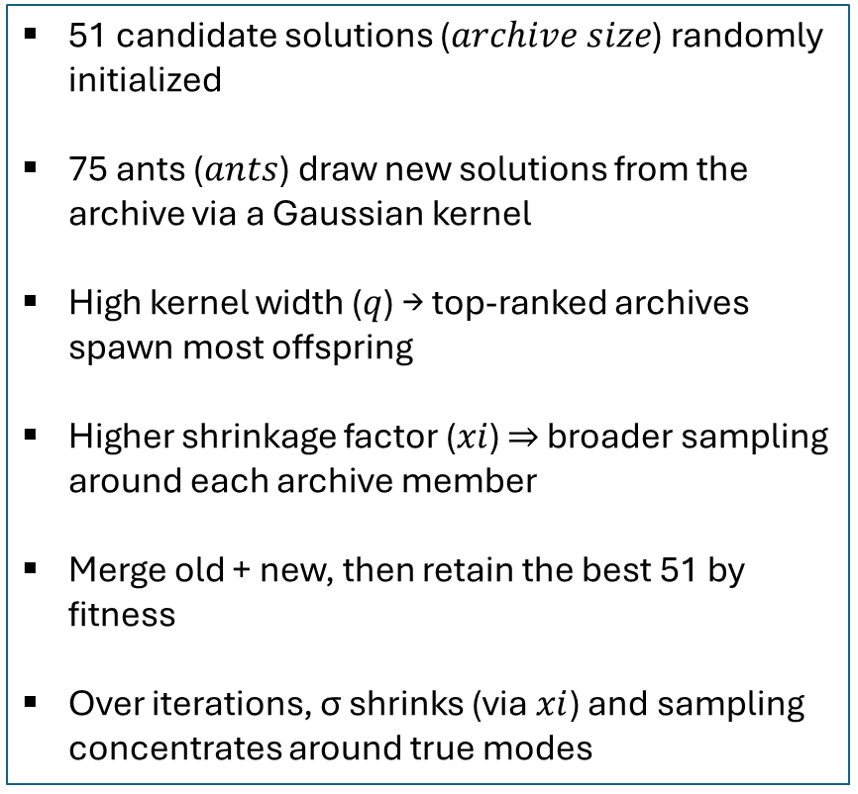
Coded examples: ACOR
Animated graph of first 2 dimensions of each particle (first cluster/centre)
51 candidate solutions ($archive size$) randomly initialized
75 ants ($ants$) draw new solutions from the archive via a Gaussian kernel
High kernel width ($q$) → top-ranked archives spawn most offspring
Higher shrinkage factor ($xi$) ⇒ broader sampling around each archive member
Merge old + new, then retain the best 51 by fitness
Over iterations, σ shrinks (via$xi$) and sampling concentrates around true modes
archive_size=51, ants=75, q=0.72, xi=0.84, n_clusters=3

